Slide 1
CSE477
VLSI Digital Circuits
Fall 2002
Lecture 12&13: Designing for Low Power
Mary Jane Irwin ( www.cse.psu.edu/~mji ) www.cse.psu.edu/~cg477
[Adapted from Rabaey’s Digital Integrated Circuits, ©2002, J. Rabaey et al.]

Slide 2
Review: Designing Fast CMOS Gates
Transistor sizing
Progressive transistor sizing
  fet closest to the output is smallest of series fets
Transistor ordering
  put latest arriving signal closest to the output
Logic structure reordering
  replace large fan-in gates with smaller fan-in gate network
Logical effort
Buffer (inverter) insertion
  separate large fan-in from large C_{L} with buffers
  uses buffers so there are no more than four TGs in series

Slide 3
Why Power Matters
Packaging costs
Power supply rail design
Chip and system cooling costs
Noise immunity and system reliability
Battery life (in portable systems)
Environmental concerns
  Office equipment accounted for 5% of total US commercial energy usage in 1993
  Energy Star compliant systems

Slide 4
Why worry about power? -- Power Dissipation
Lead microprocessors power continues to increase
100
P6
Pentium ®
10
286
486
Power (Watts)
8086
386
8085
1
8080
8008
4004
0.1
1971
1974
1978
1985
1992
2000
Year
Power delivery and dissipation will be prohibitive
Source: Borkar, De Intel®

Slide 5
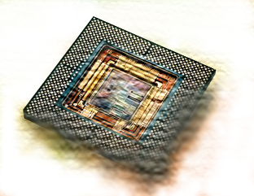
Why worry about power? -- Chip Power Density
Sun’s
10000
Surface
Rocket
1000
Nozzle
Nuclear
…chips might become hot…
100
Reactor
Power Density (W/cm2)
8086
Hot Plate
10
4004
P6
8008
8085
386
Pentium®
8080
286
486
1
1970
1980
1990
2000
2010
Year
Source: Borkar, De Intel®

Slide 6
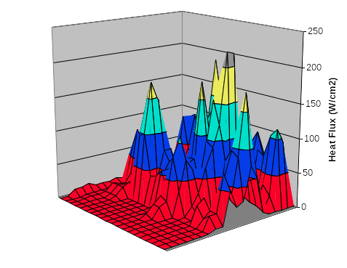
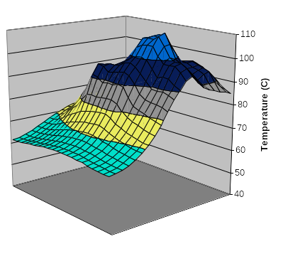
Chip Power Density Distribution
Power Map
On-Die Temperature
Power density is not uniformly distributed across the chip
Silicon is not a good heat conductor
Max junction temperature is determined by hot-spots
  Impact on packaging, w.r.t. cooling

Slide 7

Problem Illustration

Slide 8
Why worry about power ? -- Battery Size/Weight
50
Rechargable Lithium
40
Ni-Metal Hydride
30
Nominal Capacity (W-hr/lb)
20
Nickel-Cadmium
Battery
(40+ lbs)
10
0
65
70
75
80
85
90
95
Year
Expected battery lifetime increase over the next 5 years: 30 to 40%
From Rabaey, 1995
Notes:
Can’t count on battery improvements to save us!!
Note small improvement per year in battery power compared to improvements in processor complexity & speed

Slide 9

Why worry about power? -- Standby Power
Year | 2002 | 2005 | 2008 | 2011 | 2014
Power supply V_{dd} (V) | 1.5 | 1.2 | 0.9 | 0.7 | 0.6
Threshold V_{T} (V) | 0.4 | 0.4 | 0.35 | 0.3 | 0.25
Drain leakage will increase as V_{T} decreases to maintain noise margins and meet frequency demands, leading to excessive battery draining standby power consumption.
8KW
50%
…and phones leaky!
40%
1.7KW
30%
400W
Standby Power
88W
20%
12W
10%
0%
2000
2002
2004
2006
2008
Source: Borkar, De Intel®

Slide 10
Power and Energy Figures of Merit
Power consumption in Watts
  determines battery life in hours
Peak power
  determines power ground wiring designs
  sets packaging limits
  impacts signal noise margin and reliability analysis
Energy efficiency in Joules
  rate at which power is consumed over time
Energy = power * delay
  Joules = Watts * seconds
  lower energy number means less power to perform a computation at the same frequency
Notes:
power is the rate at which energy is delivered or exchanged; power dissipation is the rate at which energy is taken from the source (Vdd) and converted into heat (electrical energy is converted into heat energy during operation)
Hard to get large current into a chip (amps of current) – 30W at 3V is 10amps

Slide 11
Power versus Energy
Power is height of curve
Watts
Lower power design could simply be slower
Approach 1
Approach 2
time
Energy is area under curve
Watts
Two approaches require the same energy
Approach 1
Approach 2
time
Notes:
Energy – changing the operating frequency does not change the energy consumption!

Slide 12
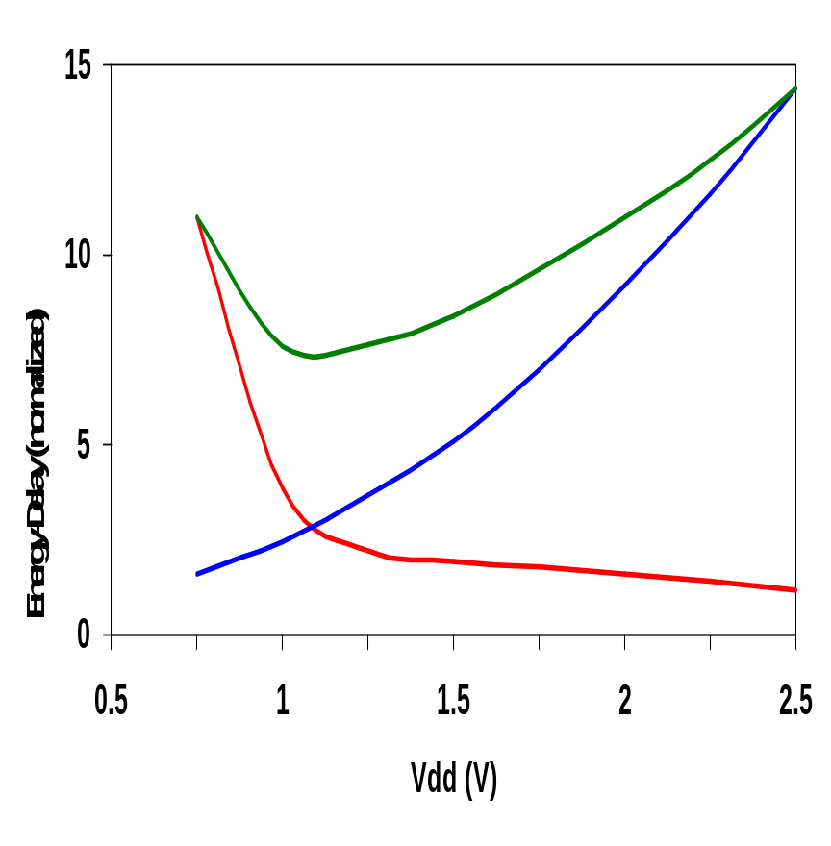
PDP and EDP
Power-delay product (PDP) = P_{av} * t_{p} = (C_{L}V_{DD}²)/2
  PDP is the average energy consumed per switching event (Watts * sec = Joule)
  lower power design could simply be a slower design
Energy-delay product (EDP) = PDP * t_{p} = P_{av} * t_{p}²
  EDP is the average energy consumed multiplied by the computation time required
  takes into account that one can trade increased delay for lower energy/operation (e.g., via supply voltage scaling that increases delay, but decreases energy consumption)
energy-delay
energy
delay
  allows one to understand tradeoffs better
Notes:
PDP stands for the average energy consumed per switching even – so its CL VDD**2 over 2
As each inverter cycle contains a 0->1 and a 1->0 transition, Eav is twice the PDP
For a given structure the PDP may be made arbitrarily low by reducing the supply voltage that comes at the expense of performance.
EDP is the preferred metric – since it takes performance into account
The optimum supply voltage can be derived (as in the book) as VDDopt = 3/2 VTE where VTE = VT + VDSAT/2.
This value of VDD optimizes both performance and energy simultaneously. For technologies with VT’s in the range of 0.5V, the optimum supply is around 1V as shown in the plot (for our generic parameters of 0.43 VTn and –0.4 VTp it is 1.2V)
Ignores standby power issues, and microarchitecture optimization issues (e.g., pipelining)

Slide 13
Understanding Tradeoffs
Which design is the “best” (fastest, coolest, both) ?
b
Energy
a
better
c
d
1/Delay
better
Notes:
For class handout

Slide 14
Understanding Tradeoffs
Which design is the “best” (fastest, coolest, both) ?
Lower
EDP
b
Energy
a
better
c
d
1/Delay
better
Notes:
For lecture
Clearly a is “better” than c and c is “better” than b, but how about b and d? Or a and d?
Constant EDP’s are the straight lines in the graph

Slide 15
CMOS Energy & Power Equations
E = C_{L} V_{DD}² P_{0→1} + t_{sc} V_{DD} I_{peak} P_{0→1} + V_{DD} I_{leakage}
P = C_{L} V_{DD}² f_{0→1} + t_{sc}V_{DD} I_{peak} f_{0→1} + V_{DD} I_{leakage}
f_{0→1} = P_{0→1} * f_{clock}
Dynamic power
Short-circuit power
Leakage power
Notes:
f0->1 represents the energy consuming transition

Slide 16
Dynamic Power Consumption
Vdd
Vin
Vout
C_{L}
f_{0→1}
Energy/transition = C_{L} * V_{DD}² * P_{0→1}
P_{dyn} = Energy/transition * f = C_{L} * V_{DD}² * P_{0→1} * f
P_{dyn} = C_{EFF} * V_{DD}² * f where C_{EFF} = P_{0→1} C_{L}
Not a function of transistor sizes!
Data dependent - a function of switching activity!
Notes:
Half of the energy is dissipated in the PMOS device, the remainder is stored on the load capacitor. Notice that this energy dissipation is independent of the size (and hence the resistance) of the PMOS device. During the high-to-low transition, this capacitor is discharged and the stored energy is dissipated in the NMOS transistor.
P0->1 is the transition probability - probability that the output is going to make the transition from 0 to 1 (the energy consuming transition). Ceff is the effective capacitance representing the average capacitance switched every clock cycle
Dynamic power accounts for 60 to 80% of the total power consumption of today’s parts.
Advances in technology result in ever higher values for f0->1 (as tp decreases). At the same time the total capacitance on the chip (CL) increases as more and more gates are placed on a single die.
With CL = 6fF, Edyn = 37.5 fJoules (for 2.5 V supply). If clocked at the maximum rate (T = 1/f = tpLH + tpHL = 2tp) then Pdyn = Edyn/(2tp) = 580 microWatts

Slide 17
Pop Quiz
Consider a 0.25 micron chip, 500 MHz clock, average load cap of 15fF/gate (fanout of 4), 2.5V supply.
  Dynamic Power consumption per gate is ??
With 1 million gates (assuming each transitions every clock)
  Dynamic Power of entire chip = ??.
Notes:
Consider a 0.25 micron chip, 500 MHz clock, average load cap of 15fF/gate (fanout of 4), 2.5V supply. Power consumption per gate is ~ 50 uW. With 1 million gates (assuming each transition every clock edge) gives 50 W.
One alternative is to lower the supply voltage as much as possible and to compensate for the loss in performance by increasing the transistor sizes. Yet this causes the capacitance to increase. At a low enough supply voltage, the capacitance (for speed) may start to dominate the power equation causing energy to increase with further drops in supply.

Slide 18
Lowering Dynamic Power
Capacitance:
Function of fan-out, wire length, transistor sizes
Supply Voltage:
Has been dropping with successive generations
P_{dyn} = C_{L} V_{DD}² P_{0→1} f
Activity factor:
How often, on average, do wires switch?
Clock frequency:
Increasing…
Notes:
Lowering C_{L}
Improves performance as well
Keep transistors minimum size (keeps intrinsic capacitance (gate and diffusion) small)
Transistors should be sized only when C_{L} is dominated by extrinsic capacitance (fanout and wires)
Reducing V_{DD} has a quadratic effect!
But has a negative effect on performance especially as V_{DD} approaches 2V_{T}
Reducing the switching activity, f_{0→1} = P_{0→1} * f
A function of signal statistics and clock rate
Impacted by logic and architecture design decisions
One alternative is to lower the supply voltage as much as possible and to compensate for the loss in performance by increasing the transistor sizes. Yet this causes the capacitance to increase. At a low enough supply voltage, the capacitance (for speed) may start to dominate the power equation causing energy to increase with further drops in supply.

Slide 19
Short Circuit Power Consumption
Vin
I_{sc}
Vout
C_{L}
Finite slope of the input signal causes a direct current path between V_{DD} and GND for a short period of time during switching when both the NMOS and PMOS transistors are conducting.
Notes:
Accounts for 20 to 40% of power of today’s technology

Slide 20
Short Circuit Currents Determinates
E_{sc} = t_{sc} V_{DD} I_{peak} P_{0→1}
P_{sc} = t_{sc} V_{DD} I_{peak} f_{0→1}
Duration and slope of the input signal, t_{sc}
I_{peak} determined by
  the saturation current of the P and N transistors which depend on their sizes, process technology, temperature, etc.
  strong function of the ratio between input and output slopes
    a function of C_{L}
Notes:
Direct path currents
tsc is when both devices are conducting – peak and duration of Isc both increase as the input slope decreases

Slide 21
Impact of C_{L} on P_{sc}
I_{sc} ≈ 0
I_{sc} ≈ I_{max}
Vin
Vout
Vin
Vout
C_{L}
C_{L}
Large capacitive load
Output fall time significantly larger than input rise time.
Small capacitive load
Output fall time substantially smaller than the input rise time.
Notes:
Left case - input moves through the transient region before the output starts to change. As the source-drain voltage of the PMOS is approximately 0 during that period, the device shuts off without ever delivering any current, so Isc is close to zero.
Right case - Drain-source voltage of PMOS equals VDD for most of the transition period, giving maximum Isc

Slide 22
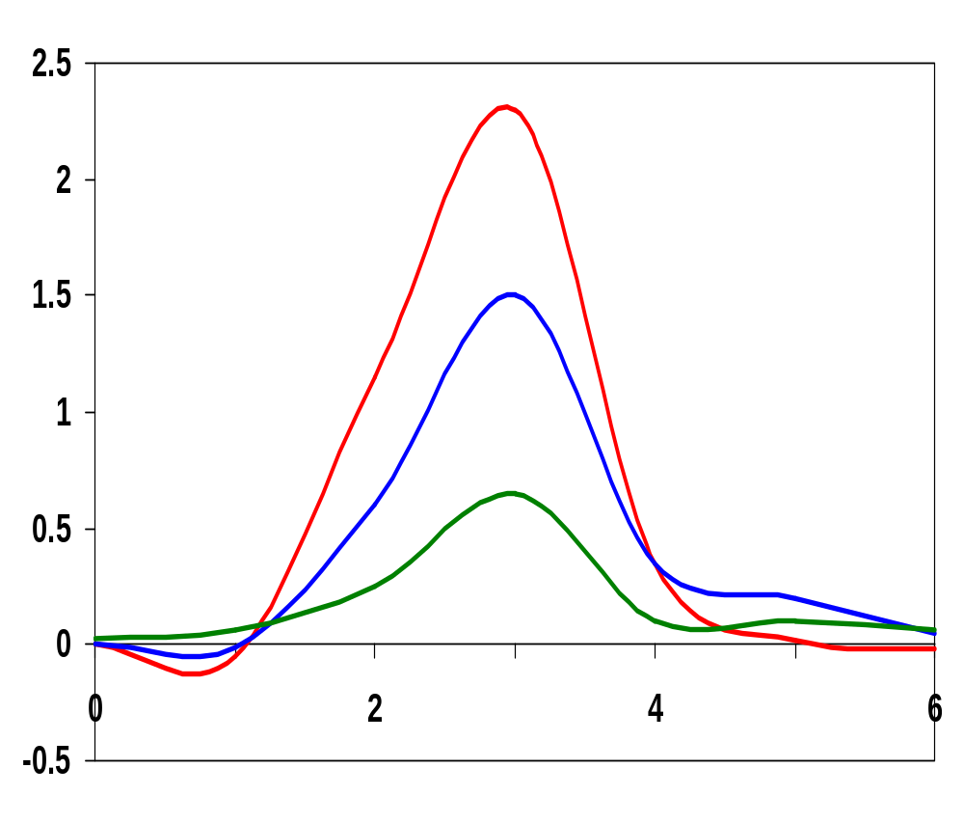
I_{peak} as a Function of C_{L}
x 10⁻⁴
When load capacitance is small, I_{peak} is large.
C_{L} = 20 fF
I_{peak} (A)
C_{L} = 100 fF
Short circuit dissipation is minimized by matching the rise/fall times of the input and output signals - slope engineering.
C_{L} = 500 fF
x 10⁻¹⁰
time (sec)
500 psec input slope
Notes:
Making the output rise/fall time too large slows down the circuit and can cause short-circuit currents in the fan-out gates!
SLOPE ENGINEERING – is important for BOTH speed and power consumption
However, its not the optimum solution for a gate on its own (just keeps the overall short-circuit current within bounds). For a single inverter, see next slide . . .

Slide 23
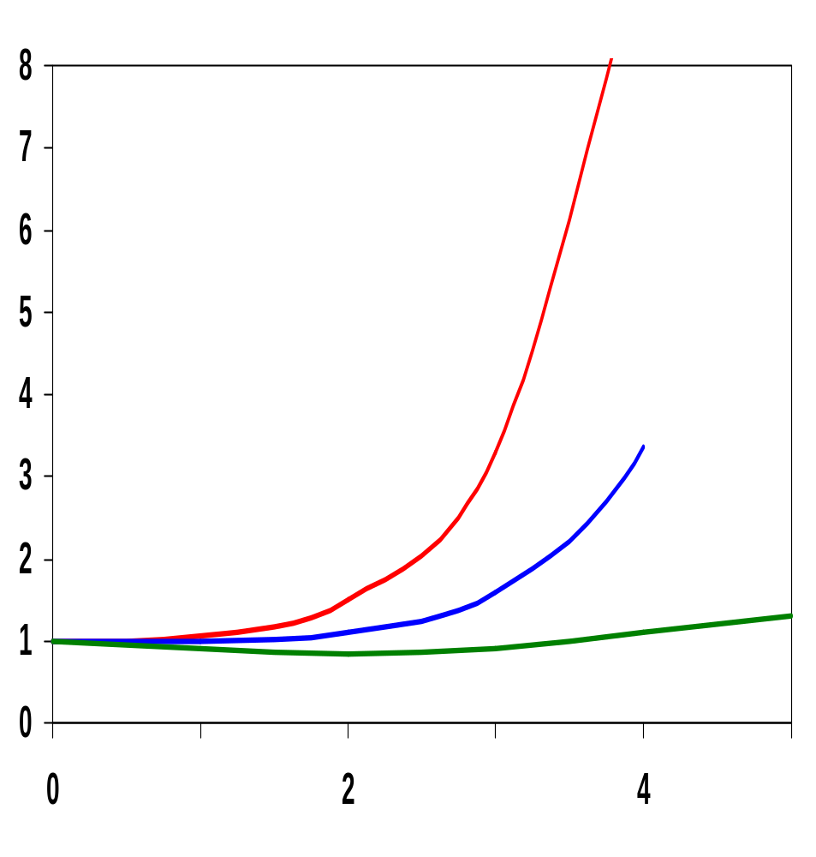
P_{sc} as a Function of Rise/Fall Times
When load capacitance is small (t_{sin}/t_{sout} > 2 for V_{DD} > 2V) the power is dominated by P_{sc}
V_{DD}= 3.3 V
P normalized
V_{DD} = 2.5 V
If V_{DD} < V_{Tn} + |V_{Tp}| then P_{sc} is eliminated since both devices are never on at the same time.
V_{DD} = 1.5V
t_{sin}/t_{sout}
W/L_{p} = 1.125 μm/0.25 μm
W/L_{n} = 0.375 μm/0.25 μm
C_{L} = 30 fF
normalized wrt zero input rise-time dissipation
Notes:
For large capacitance values, all the power dissipation is devoted to charging and discharging the load capacitance. When the rise/fall times of inputs and outputs are equalized, most power dissipation is associated with dynamic power and only a minor fraction (<10%) is devoted to Psc.
At VDD=2.5V and VTs around 0.5V, an input/output slope ratio of 2 is needed to cause a 10% degradation in power dissipation.
Also notice that short-circuit current is reduced when we lower the supply voltage. In the extreme, when VDD < VTn + |VTp|, short-circuit current is completely eliminated.
With threshold voltages scaling at a slower rate than the supply voltage, Psc is becoming less important in vDSM.

Slide 24
Leakage (Static) Power Consumption
V_{DD} I_{leakage}
Vout
Drain junction leakage
Gate leakage
Sub-threshold current
Sub-threshold current is the dominant factor.
All increase exponentially with temperature!
Notes:
For drain junction: Leakage current per unit drain area typically ranges between 10 and 100 picoA/micron**2 at room temperature (25 degrees C) for 0.25 micron CMOS (1 million gates, each with drain area of 0.5 micron**2 = 0.125 milliW).
However, values increase with increasing junction temperature - exponentially! JS doubles for every 9 deg C! At 85 degrees C (commonly imposed upper bound for junction temperatures) the leakage currents increase by a factor of 60 over room temperature. As temperature is a strong function of the dissipated heat and its removal mechanisms – limit power heat and use chip packages that support efficient heat removal.
Have to be more concerned about sub-threshold current. The closer the threshold voltage is to zero, the larger the leakage current at VGS = 0 V. To offset this effect, threshold voltages are not scaled as aggressively as supply voltages (narrowing noise margins). Unfortunately, scaling the supply voltage and not scaling threshold hurts performance, esp as VDD approaches 2 VT.

Slide 25
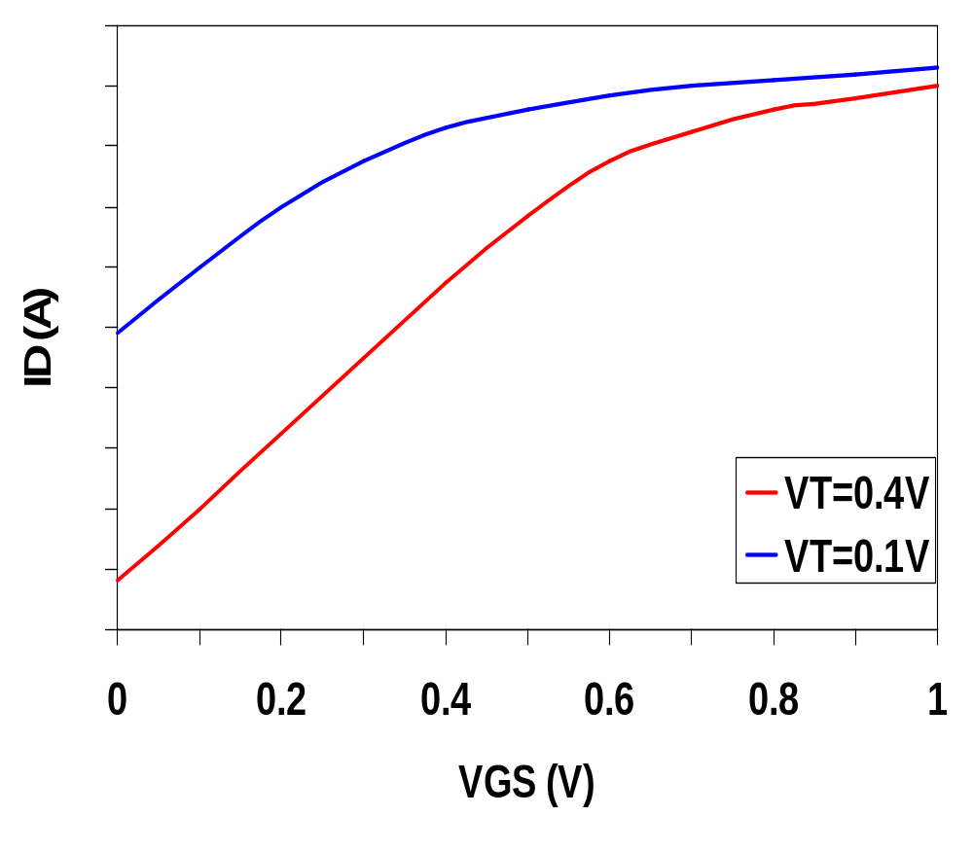
Leakage as a Function of V_{T}
Continued scaling of supply voltage and the subsequent scaling of threshold voltage will make subthreshold conduction a dominate component of power dissipation.
10⁻²
An 90mV/decade V_{T} roll-off - so each 255mV increase in V_{T} gives 3 orders of magnitude reduction in leakage (but adversely affects performance)
10⁻⁷
10⁻¹²
Notes:
The choice of VT represents a trade-off between performance and static power dissipation. Process technologies with sharper turn-off characteristics (like SOI with slope factors closer to the ideal 60mV/decade) will become more attractive. With sizable static power dissipation, it is essential that non-active modules are powered-down (put in standby) by disconnecting the unit from the supply rails or by lowering the supply voltage.
There are other leakage factors that we are ignoring here including: Drain-Induced Barrier Lowering (I₃)
Gate-Induced Drain Leakage (I₄)
Punchthrough (I₅)
Narrow Width Effect (I₆)
Gate Oxide Tunneling (I₇)
Hot Carrier(I₈)

Slide 26
TSMC Processes Leakage and V_{T}
CL018 G
CL018 LP
CL018 ULP
CL018 HS
CL015 HS
CL013 HS
V_{dd}
1.8 V
1.8 V
1.8 V
2 V
1.5 V
1.2 V
T_{ox} (effective)
42 Å
42 Å
42 Å
42 Å
29 Å
24 Å
L_{gate}
0.16 μm
0.16 μm
0.18 μm
0.13 μm
0.11 μm
0.08 μm
I_{DSat} (n/p) (μA/μm)
600/260
500/180
320/130
780/360
860/370
920/400
I_{off} (leakage) (ρA/μm)
20
1.60
0.15
300
1,800
13,000
V_{Tn}
0.42 V
0.63 V
0.73 V
0.40 V
0.29 V
0.25 V
FET Perf. (GHz)
30
22
14
43
52
80
From MPR, 2000
Notes:
From MPR, June 2000, pp. 19 – Performance of various TSMC processes (G generic, LP low power, ULP ultra low power, HS high speed)

Slide 27
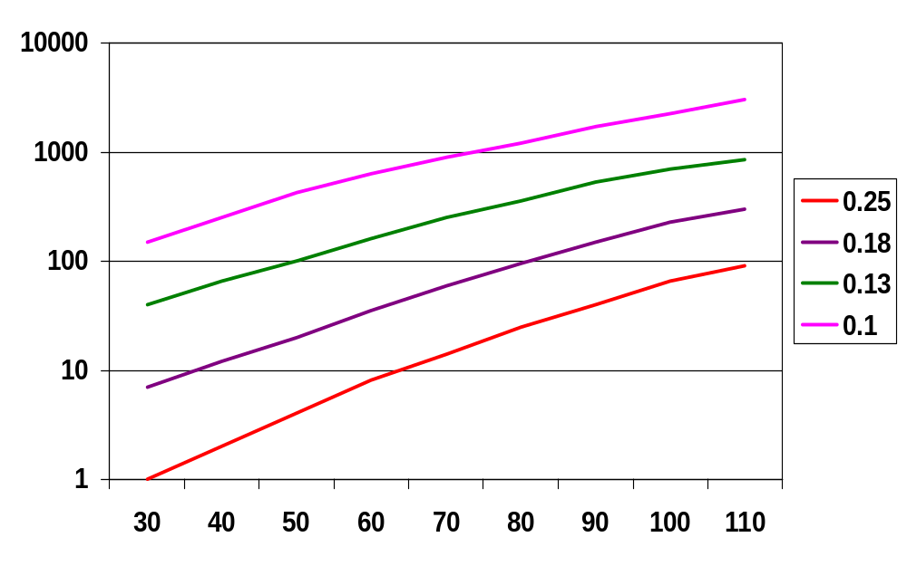
Exponential Increase in Leakage Currents
I_{leakage}(nA/μm)
Temp(C)
From De,1999
Notes:
Note y axis is log – doubles for every 10 degree increase in temperature
Will leakage power still be 6 orders of magnitude smaller (as it is today) than dynamic power for future technologies even at room temperature.
Example – the following configurations have the same power performance:
3V VDD, 0.7V VT and a 0.45V VDD, 0.1V VT
The dynamic power consumption of the latter is, however, 45 times smaller.

Slide 28
Review: Energy & Power Equations
E = C_{L} V_{DD}² P_{0→1} + t_{sc} V_{DD} I_{peak} P_{0→1} + V_{DD} I_{leakage}
P = C_{L} V_{DD}² f_{0→1} + t_{sc}V_{DD} I_{peak} f_{0→1} + V_{DD} I_{leakage}
f_{0→1} = P_{0→1} * f_{clock}
Dynamic power
(~90% today and decreasing relatively)
Short-circuit power
(~8% today and decreasing absolutely)
Leakage power
(~2% today and increasing)
Notes:
f0->1 represents the energy consuming transition

Slide 29
Power and Energy Design Space
 | Constant Throughput/Latency |  | Variable Throughput/Latency
Energy | Design Time | Non-active Modules |  | Run Time
Active | Logic Design Reduced V_{dd} Sizing Multi-V_{dd} | Clock Gating |  | DFS, DVS (Dynamic Freq, Voltage Scaling)
Leakage | + Multi-V_{T} | Sleep Transistors Multi-V_{dd} Variable V_{T} |  | + Variable V_{T}
Notes:
Columns are enable time – when they are implemented
Rows are targeted dissipation source

Slide 30
Dynamic Power as a Function of Device Size
Device sizing affects dynamic energy consumption
  gain is largest for networks with large overall effective fan-outs (F = C_{L}/C_{g,1})
The optimal gate sizing factor (f) for dynamic energy is smaller than the one for performance, especially for large F’s
  e.g., for F=20, f_{opt}(energy) = 3.53 while f_{opt}(performance) = 4.47
If energy is a concern avoid oversizing beyond the optimal
1.5
F=1
F=2
1
normalized energy
F=5
0.5
F=10
F=20
0
1
2
3
4
5
6
7
f
From Nikolic, UCB
Notes:
Device sizing COMBINED with supply voltage reduction is a very effective way to reduce the energy consumption of a logic network. Especially true for networks with large effective fanout (F) where energy reductions of a factor of 10 can be obtained (except when F=1 when minimum size should be used).
Oversizing comes at a hefty price in energy.
The optimal sizing factor for energy is smaller than the one for performance.

Slide 31
Dynamic Power Consumption is Data Dependent
Switching activity, P_{0→1}, has two components
  A static component – function of the logic topology
  A dynamic component – function of the timing behavior (glitching)
Static transition probability
P_{0→1} = P_{out=0} x P_{out=1}
= P₀ x (1-P₀)
2-input NOR Gate
A | B | Out
0 | 0 | 1
0 | 1 | 0
1 | 0 | 0
1 | 1 | 0
With input signal probabilities
P_{A=1} = 1/2
P_{B=1} = 1/2
NOR static transition probability
= 3/4 x 1/4 = 3/16
Notes:
Assumes inputs of 0 and 1 are equally likely.
Take away is that output probabilities are NOT uniform

Slide 32
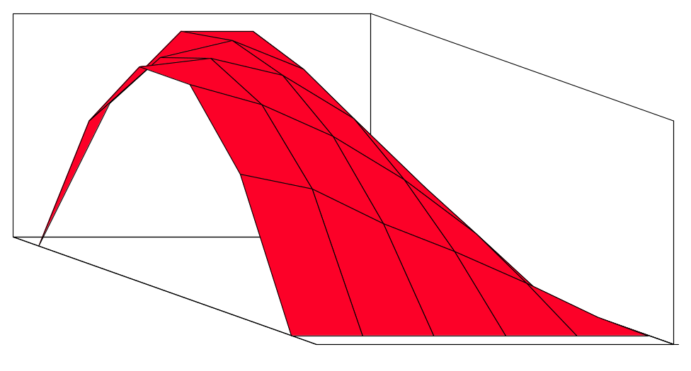
NOR Gate Transition Probabilities
Switching activity is a strong function of the input signal statistics
  P_{A} and P_{B} are the probabilities that inputs A and B are one
A
B
0
A
B
C_{L}
P_{A}
1
0
1
P_{B}
P_{0→1} = P₀ x P₁ = (1-(1-P_{A})(1-P_{B})) (1-P_{A})(1-P_{B})
Notes:
Understanding the signal statistics and their impact on switching events can be used to significantly impact the power dissipation.
Observe how the graph degrades into the simple inverter case when one of the input probabilities is set to 0

Slide 33
Transition Probabilities for Some Basic Gates
 | P_{0→1} = P_{out=0} x P_{out=1}
NOR | (1 - (1 - P_{A})(1 - P_{B})) x (1 - P_{A})(1 - P_{B})
OR | (1 - P_{A})(1 - P_{B}) x (1 - (1 - P_{A})(1 - P_{B}))
NAND | P_{A}P_{B} x (1 - P_{A}P_{B})
AND | (1 - P_{A}P_{B}) x P_{A}P_{B}
XOR | (1 - (P_{A} + P_{B}- 2P_{A}P_{B})) x (P_{A} + P_{B}- 2P_{A}P_{B})
0.5
X
A
Z
0.5
B
For X: P_{0→1} =
For Z: P_{0→1} =
Notes:
For class handout

Slide 34
Transition Probabilities for Some Basic Gates
 | P_{0→1} = P_{out=0} x P_{out=1}
NOR | (1 - (1 - P_{A})(1 - P_{B})) x (1 - P_{A})(1 - P_{B})
OR | (1 - P_{A})(1 - P_{B}) x (1 - (1 - P_{A})(1 - P_{B}))
NAND | P_{A}P_{B} x (1 - P_{A}P_{B})
AND | (1 - P_{A}P_{B}) x P_{A}P_{B}
XOR | (1 - (P_{A} + P_{B}- 2P_{A}P_{B})) x (P_{A} + P_{B}- 2P_{A}P_{B})
0.5
X
A
Z
0.5
B
For X: P_{0→1} = P₀ x P₁ = (1-P_{A}) P_{A}
= 0.5 x 0.5 = 0.25
For Z: P_{0→1} = P₀ x P₁ = (1-P_{X}P_{B}) P_{X}P_{B}
= (1 – (0.5 x 0.5)) x (0.5 x 0.5) = 3/16
Notes:
For lecture.
Ignoring signal statistics can result in substantial errors in energy/power estimation
Need to look at the truth tables to understand the equations.
Computation of the probabilities is straightforward: signal and transition probabilities are evaluated in an ordered fashion progressing from input to output node. Approach has two major limitations:
1-it does not deal with circuits with feedback
2-it assumes that the signal probabilities at the input of each gate are independent.

Slide 35
Inter-signal Correlations
Determining switching activity is complicated by the fact that signals exhibit correlation in space and time
  reconvergent fan-out
0.5
A
X
0.5
B
Z
Reconvergent fan-out
P(Z=1) = P(B=1) & P(A=1 | B=1)
Have to use conditional probabilities
Notes:
For class handout.
Assume PA = PB = 0.5

Slide 36
Inter-signal Correlations
Determining switching activity is complicated by the fact that signals exhibit correlation in space and time
  reconvergent fan-out
(1-0.5)(1-0.5)x(1-(1-0.5)(1-0.5)) = 3/16
0.5
A
X
0.5
B
Z
(1- 3/16 x 0.5) x (3/16 x 0.5) = 0.085
Reconvergent
P(Z=1) = P(B=1) & P(A=1 | B=1)
Have to use conditional probabilities
Notes:
For lecture.
Even if the primary inputs are uncorrelated, the signals become correlated (“colored”) as they propagate through the logic network.
Assume PA = PB = 0.5
But notice that Z = (A or B) and B = AB or B = B, so 0 -> 1 should be (and is) 1/2 x 1/2 = 1/4 !!!

Slide 37
Logic Restructuring
Logic restructuring: changing the topology of a logic network to reduce transitions
AND: P_{0→1} = P₀ x P₁ = (1 - P_{A}P_{B}) x P_{A}P_{B}
3/16
0.5
0.5
(1-0.25)*0.25 = 3/16
A
Y
A
W
7/64
B
0.5
15/256
B
X
F
15/256
0.5
0.5
C
C
0.5
D
F
D
Z
0.5
0.5
3/16
Chain implementation has a lower overall switching activity than the tree implementation for random inputs
Ignores glitching effects
Notes:
Look at designing for speed – 8-input AND gate. Which implementation is lower energy? Which is lower delay? So which is better overall?
Also look at slide speed.19, Design Technique 3 – when deciding which configuration consumes less power and has the best performance

Slide 38
Input Ordering
0.5
0.2
A
B
X
X
B
C
F
0.1
A
F
0.2
C
0.1
0.5
Beneficial to postpone the introduction of signals with a high transition rate (signals with signal probability close to 0.5)
Notes:
For class handout

Slide 39
Input Ordering
(1-0.5x0.2)x(0.5x0.2)=0.09
(1-0.2x0.1)x(0.2x0.1)=0.0196
0.5
0.2
A
B
X
X
B
C
F
0.1
A
F
0.2
C
0.1
0.5
Beneficial to postpone the introduction of signals with a high transition rate (signals with signal probability close to 0.5)
Notes:
For lecture
Activity at output node, F, equal in both cases

Slide 40
Glitching in Static CMOS Networks
Gates have a nonzero propagation delay resulting in spurious transitions or glitches (dynamic hazards)
  glitch: node exhibits multiple transitions in a single cycle before settling to the correct logic value
A
X
B
C
Z
ABC
101
000
X
Z
Unit Delay
Notes:
For class handout

Slide 41
Glitching in Static CMOS Networks
Gates have a nonzero propagation delay resulting in spurious transitions or glitches (dynamic hazards)
  glitch: node exhibits multiple transitions in a single cycle before settling to the correct logic value
A
X
B
C
Z
ABC
101
000
X
Z
Unit Delay
Notes:
For lecture
Assumes unit delay model (gates have non zero delay)
Shaded area is a glitch (aka critical race, dynamic hazard)

Slide 42
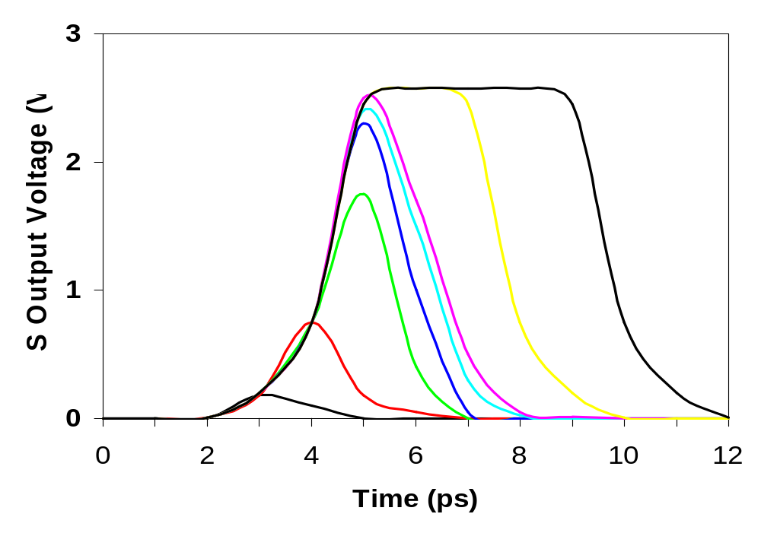
Glitching in an RCA
Cin
S15
S14
S2
S1
S0
S3
S4
S15
Cin
S2
S5
S10
S1
S0
Notes:
Due to ripple of carry from cin to Add15

Slide 43
Balanced Delay Paths to Reduce Glitching
Glitching is due to a mismatch in the path lengths in the logic network; if all input signals of a gate change simultaneously, no glitching occurs
0
0
0
F₁
1
0
F₁
1
0
F₂
2
F₃
0
F₃
0
0
F₂
1
So equalize the lengths of timing paths through logic
Notes:
If you can arrange it so that all the inputs change simultaneously -> no glitching
Making the path lengths to the inputs of a gate approximately the same is usually sufficient to eliminate glitches - delay balancing

Slide 44
Power and Energy Design Space
 | Constant Throughput/Latency |  | Variable Throughput/Latency
Energy | Design Time | Non-active Modules |  | Run Time
Active | Logic Design Reduced V_{dd} Sizing Multi-V_{dd} | Clock Gating |  | DFS, DVS (Dynamic Freq, Voltage Scaling)
Leakage | + Multi-V_{T} | Sleep Transistors Multi-V_{dd} Variable V_{T} |  | + Variable V_{T}

Slide 45
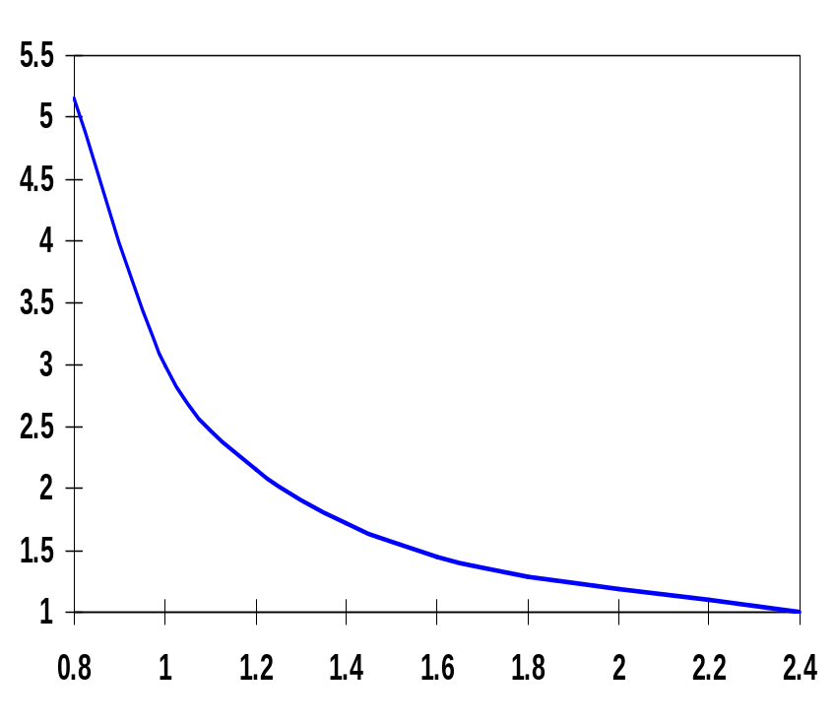
Dynamic Power as a Function of V_{DD}
Decreasing the V_{DD} decreases dynamic energy consumption (quadratically)
But, increases gate delay (decreases performance)
t_{p(normalized)}
V_{DD} (V)
Determine the critical path(s) at design time and use high V_{DD} for the transistors on those paths for speed. Use a lower V_{DD} on the other gates, especially those that drive large capacitances (as this yields the largest energy benefits).
Notes:
Propagation delay of a CMOS inverter as a function of supply voltage (normalized wrt delay at 2.5V supply). While the delay is relatively insensitive to supply variations for higher values of VDD, a sharp increase can be observed starting around 2VT. This operation regions should be avoided for high performance! Increasing VDD also has reliability concerns - oxide breakdown, hot-electron effects - that enforce firm upper bounds on the supply voltage in deep submicron processes. Lowering VDD slows down the gate!

Slide 46
Multiple V_{DD} Considerations
How many V_{DD}? – Two is becoming common
  Many chips already have two supplies (one for core and one for I/O)
When combining multiple supplies, level converters are required whenever a module at the lower supply drives a gate at the higher supply (step-up)
  If a gate supplied with V_{DDL} drives a gate at V_{DDH}, the PMOS never turns off
    The cross-coupled PMOS transistors do the level conversion
    The NMOS transistor operate on a reduced supply
  Level converters are not needed for a step-down change in voltage
  Overhead of level converters can be mitigated by doing conversions at register boundaries and embedding the level conversion inside the flipflop (see Figure 11.47)
V_{DDH}
V_{out}
V_{DDL}
V_{in}
Notes:
The delay of the level converter is quite sensitive to transistor sizing and supply voltage fluctuations. For a low VDDL, the delay can become very long. (Since the NMOS operate with a reduced drive (VDDL-VT) they have to be made larger to be able to overpower the feedback).

Slide 47
Dual-Supply Inside a Logic Block
Minimum energy consumption is achieved if all logic paths are critical (have the same delay)
Clustered voltage-scaling
  Each path starts with V_{DDH} and switches to V_{DDL} (gray logic gates) when delay slack is available
  Level conversion is done in the flipflops at the end of the paths
Notes:
A number of studies have shown that for typical delay path distributions, adding more supplies (than two) yields only marginal additional savings.
When using clustered voltage scaling, the dual-supply approach is more effective when large capacitances are concentrated towards the end of the logic block (such as in buffer chains).

Slide 48
Power and Energy Design Space
 | Constant Throughput/Latency |  | Variable Throughput/Latency
Energy | Design Time | Non-active Modules |  | Run Time
Active | Logic Design Reduced V_{dd} Sizing Multi-V_{dd} | Clock Gating |  | DFS, DVS (Dynamic Freq, Voltage Scaling)
Leakage | + Multi-V_{T} | Sleep Transistors Multi-V_{dd} Variable V_{T} |  | + Variable V_{T}

Slide 49
Stack Effect
Leakage is a function of the circuit topology and the value of the inputs
V_{T} = V_{T0} + γ(√|-2φ_{F} + V_{SB}| - √|-2φ_{F}|)
where V_{T0} is the threshold voltage at V_{SB} = 0; V_{SB} is the source- bulk (substrate) voltage; γ is the body-effect coefficient
A | B | V_{X} | I_{SUB}
0 | 0 | V_{T} ln(1+n) | V_{GS}=V_{BS}= -V_{X}
0 | 1 | 0 | V_{GS}=V_{BS}=0
1 | 0 | V_{DD}-V_{T} | V_{GS}=V_{BS}=0
1 | 1 | 0 | V_{SG}=V_{SB}=0
A
B
Out
A
V_{X}
B
Leakage is least when A = B = 0
Leakage reduction due to stacked transistors is called the stack effect
Notes:
Maximum leakage reduction occurs when all the transistors in the stack are off and the intermediate node voltages research their steady state value.
n is empirical parameter, with n >= 1 and typically ranging around 1.5. For an ideal transistor with the sharpest possible roll-off, n = 1 (where S = 60 mV/decade which means that the subthreshold current drops by a factor of 10 for a reduction in VGS of 60mV). Unfortunately, n is more like 1.5 for actual devices (so S = 90 mV/decade). The current roll-off is further decreased by a rise in the operating temperature.

Slide 50
Short Channel Factors and Stack Effect
In short-channel devices, the subthreshold leakage current depends on V_{GS},V_{BS} and V_{DS}. The V_{T} of a short-channel device decreases with increasing V_{DS} due to DIBL (drain-induced barrier loading).
  Typical values for DIBL are 20 to 150mV change in V_{T} per voltage change in V_{DS} so the stack effect is even more significant for short-channel devices.
  V_{X} reduces the drain-source voltage of the top nfet, increasing its V_{T} and lowering its leakage
For our 0.25 micron technology, V_{X} settles to ~100mV in steady state so V_{BS} = -100mV and V_{DS} = V_{DD} -100mV which is 20 times smaller than the leakage of a device with V_{BS} = 0mV and V_{DS} = V_{DD}

Slide 51
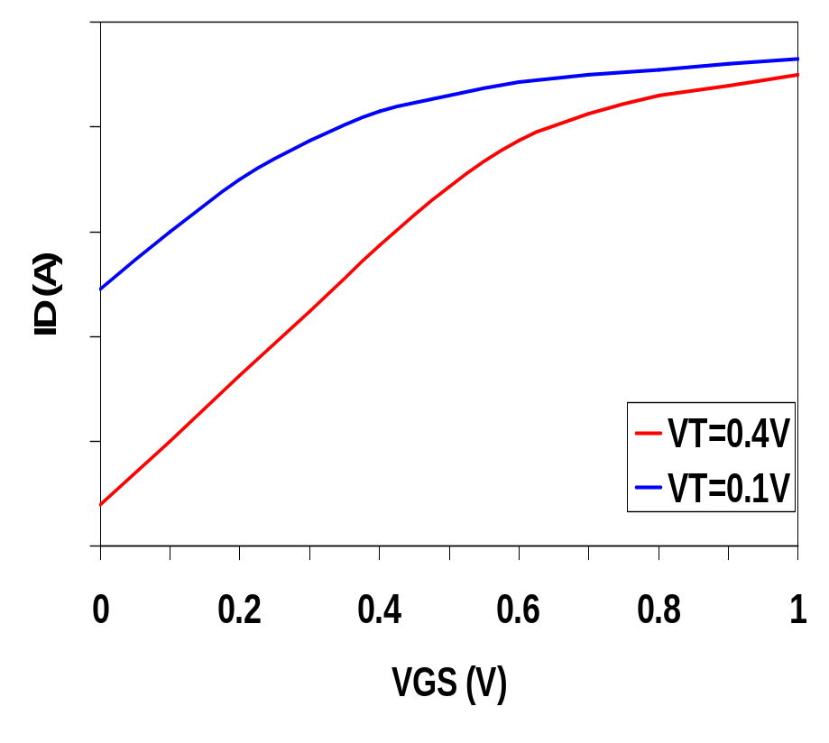
Leakage as a Function of Design Time V_{T}
Reducing the V_{T} increases the sub-threshold leakage current (exponentially)
  90mV reduction in V_{T} increases leakage by an order of magnitude
But, reducing V_{T} decreases gate delay (increases performance)
Determine the critical path(s) at design time and use low V_{T} devices on the transistors on those paths for speed. Use a high V_{T} on the other logic for leakage control.
  A careful assignment of V_{T}’s can reduce the leakage by as much as 80%
Notes:
Most sub-0.25micron CMOS technologies offer two types of n- and p-type transistors with thresholds differing by about 100mV. The higher threshold device has leakage current about one order of magnitude lower than the lower threshold device a the expense of a ~ 30% reduction in active current (i.e., lower performance).
Note that the use of multiple thresholds does not require level converters and can be done on a per-cell transistor basis; clustering of the logic is not required (as in multiple VDD). Does incur some small area penalty.
Also gives a small reduction in active power due to the reduced gate-to-channel capacitance in the off state and a small reduction in signal swing on the internal nodes of a gate (VDD – VTH) (partially offset by increase source and drain junction sidewall capacitance) - its only about 4%

Slide 52
Dual-Thresholds Inside a Logic Block
Minimum energy consumption is achieved if all logic paths are critical (have the same delay)
Use lower threshold on timing-critical paths
  Assignment can be done on a per gate or transistor basis; no clustering of the logic is needed
  No level converters are needed

Slide 53
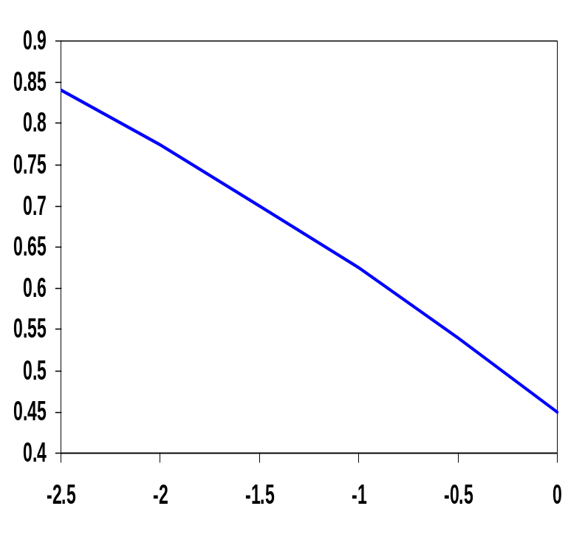
Variable V_{T} (ABB) at Run Time
V_{T} = V_{T0} + γ(√|-2φ_{F} + V_{SB}| - √|-2φ_{F}|)
For an n-channel device, the substrate is normally tied to ground (V_{SB} = 0)
A negative bias on V_{SB} causes V_{T} to increase
Adjusting the substrate bias at run time is called adaptive body-biasing (ABB)
  Requires a dual well fab process
V_{T} (V)
V_{SB} (V)
Notes:
Requires a dual well fab process

Slide 54
Next Lecture and Reminders
Next lecture (after midterm)
  Dynamic logic
    Reading assignment – Rabaey, et al, 6.3
Reminders
  HW3 due Oct 10th (hand in to TA)
  Class cancelled on Oct 10th as make up for evening midterm
  Class cancelled on Oct 15th due to fall break
  I will be out of town Oct 10th through Oct 15th and Oct 18th through Oct 23rd, so office hours during those periods are cancelled
  There will be a guest lecturer on Oct 22nd
  Evening midterm exam scheduled
    Wednesday, October 16th from 8:15 to 10:15pm in 260 Willard
    Only one midterm conflict filed for so far

